Slide 1
Off-Boarding Process
A Data Management and Business Process Modeling Project
OPIM 5272 S23 - Group 6
Jamie Howe, Jessica Prevo, Kevin Connolly, Prathyusha Kalepalli, Sai Venu Sagar Jakkula
Notes:
Prath

Slide 2
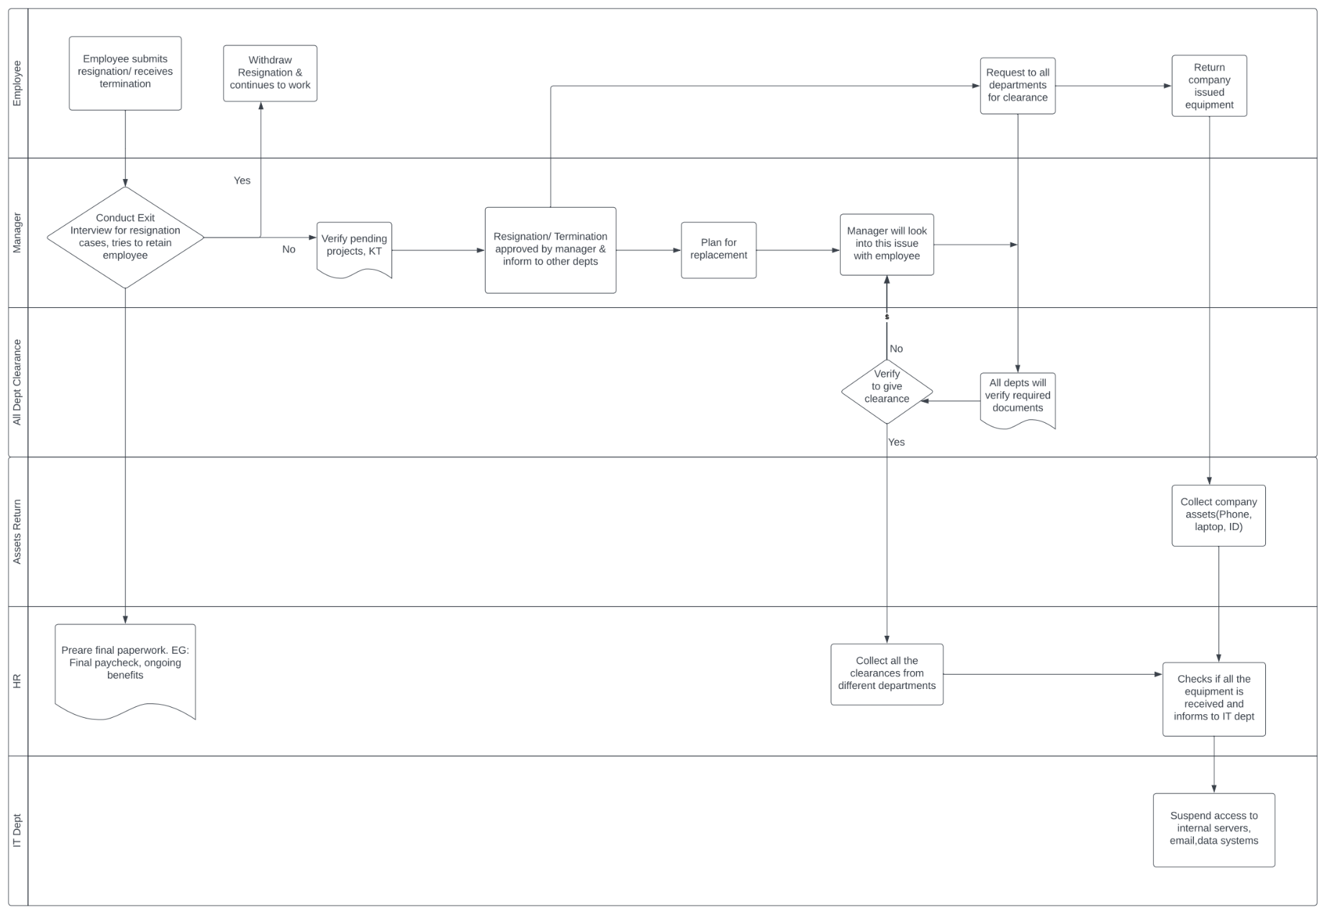
Background & As-Is Process
Notes:
Prath
The company's existing offboarding process takes a lot of time because an employee must obtain authorization from ten or more departments to return their equipment, turn off IT accesses, etc. Each department must be contacted and given at least 24 hours to respond.
The complicated process causes significant delays in the offboarding process, and the employee must devote a lot of time to offboarding while also working on closing out their ongoing assignments.

Slide 3






Pain Points & Solution
Problems in AS-IS:
Time
Effort
Risk
Solution:
Paperwork
Communication
Simplifying Process
Notes:
Prath

Slide 4
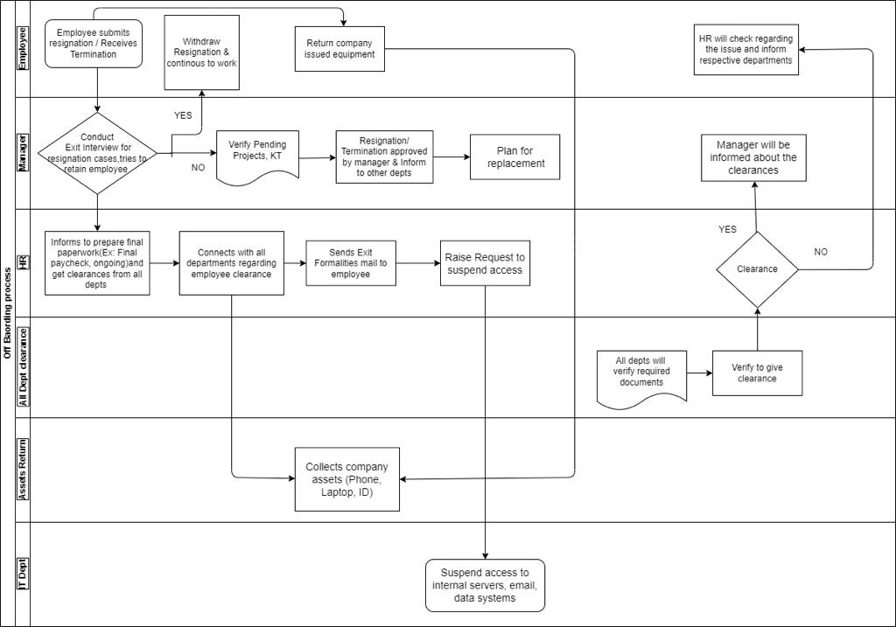
To-Be Process
Notes:
Prath
Problems with As-Is Process:
The company's existing offboarding process takes a lot of time because an employee must obtain authorization from ten or more departments.
The complicated process causes significant delays in the offboarding process.
Solutions:
Simplifying the clearance process and minimizing the number of requests and follow-ups with different departments.
Centralizing the communication and coordination for offboarding with HR, minimizing the chances of miscommunication or confusion.
Streamlining the paperwork, pay, and benefits process, making it more efficient for the HR department.

Slide 5
Business Rules & Benefits
Business Rules
Benefits
One Employee →
One Department
Must have an HR manager and a functional manager
One job at a time
Company Access
Reduced burden
Smoother transitions
Centralized communication
Completion of projects
Notes:
Venu
Business Rules
An employee can work in only one department
Each department must have an HR manager and a functional manager
An employee can hold only one job at a time
Each job title has a job description, minimum salary, and maximum salary
An employee can own or have access to company assets, and the ownership/access can have a start and end date
Benefits
Reduced burden on outgoing employee
simplifying the clearance process
minimizing the follow-ups needed
Ensuring employee's projects are completed
Smooth transition to backfill employee
Central communication for HR

Slide 6
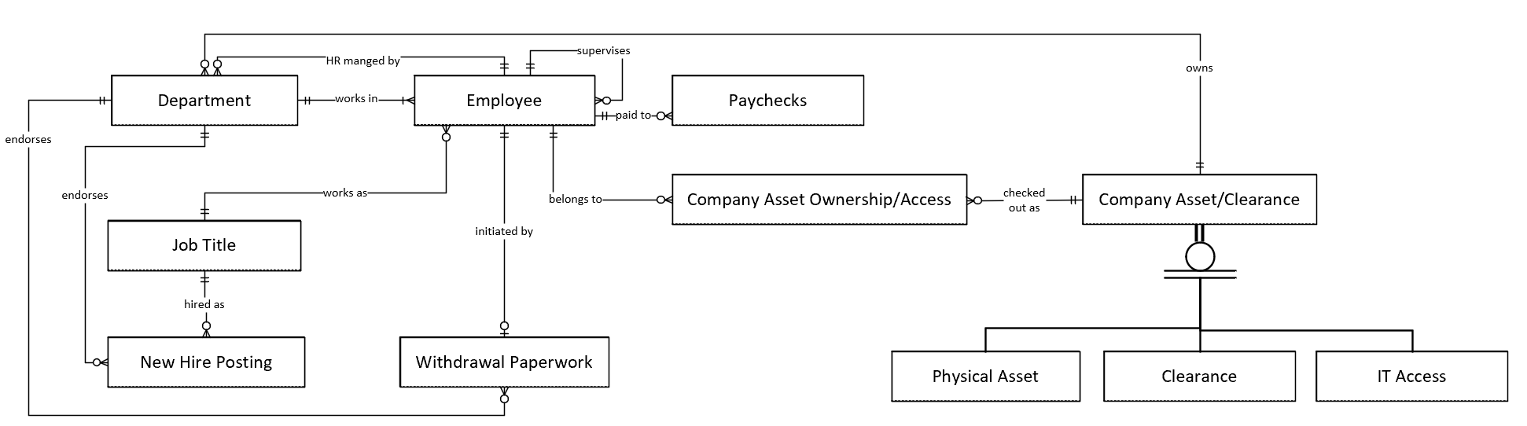

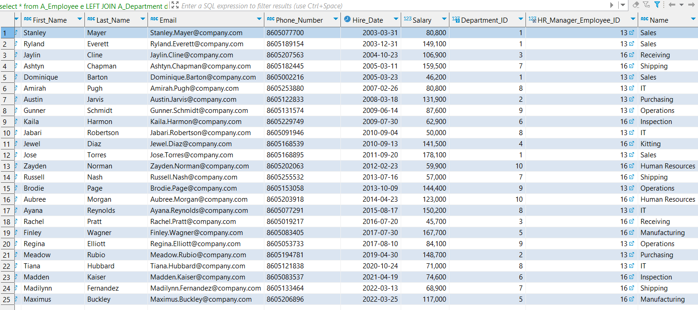
Enhanced Entity Relationship Diagram (ERD) & Example Records
Difficulties:
Multiple relationships between employee and department
Desire to have endorsements on the Withdrawal Paperwork and New Hire Postings
Record Creation:
Generic or AI generated data was populated for this proof of concept database.
PK and FK were manually created.
Notes:
Jess & Jamie

Slide 7
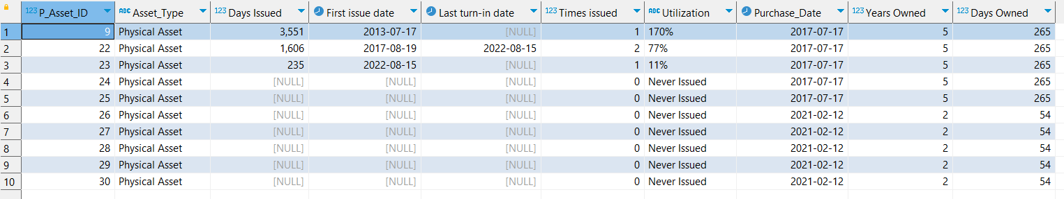
Utilization Report
Purpose: Utilization report of all individual equipment important to the business.
Use In Business Metric: Percent utilization of acquired personal equipment
Benefit: Useful for identifying whether there is existing stock of equipment available to be assigned to new hires or sold off if equipment is not needed to satisfy the needs of new postings.
Notes:
Jaime & Kevin

Slide 8
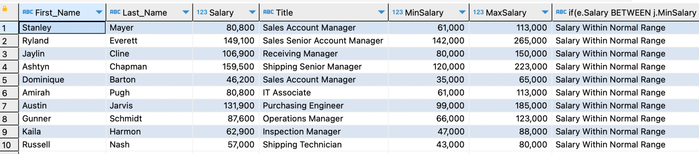
Salary Review Report
Purpose: HR Review that Offboarded Employees Salary is within industry norm.
Benefit: Checks that company salaries are competitive
Use In Business Metric: Salary guidance to HR for employees that will be replacing the offboarded
Report Confirms Salaries of Resigned Employees are in Line with Industry Norms
Notes:
Kevin

Slide 9
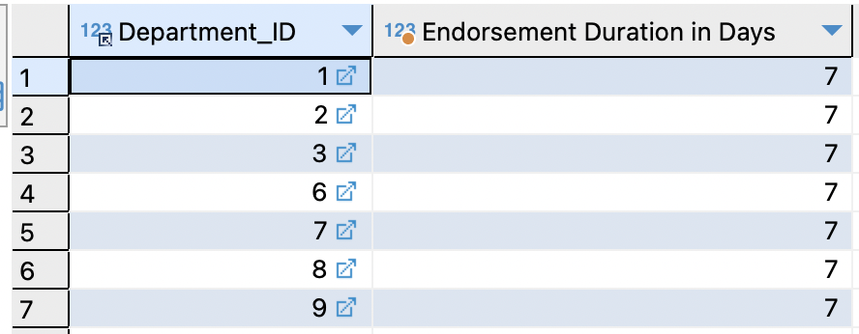
Process Duration Report
Purpose: Report shows process improvement
Benefit: Ensures the offboarding process is closing within the employee notice duration.
Use In Business Metric: Ensuring that all the employee's projects are completed before their last day, reducing the risk of unfinished work or delays.
Report Confirms New Process Achieves Timely Off-boarding for All Departments
Notes:
Kevin

Slide 10
In Conclusion
Why Change?
Inefficiency
Interrupted Operations
Revoking Clearances Causes Delays
Impact to the Bottom Line
Recommendations
Standardized Process
Clear and Accessible
More Automation in Revoking Clearances
Clarified Timelines and Responsibilities
Facilitate Transitions
Continuous Improvement
Notes:
Jess
Why Change?
To make it more efficient and less time-consuming for employees.
To Ensure that the company's operations continue uninterrupted after an employee leaves.
The current process of revoking clearances from various departments can lead to significant delays in completing the offboarding process.
A smoother offboarding process can minimize disruptions to company operations and ultimately impact the bottom line positively.
Recommendations
Develop a clear and standardized offboarding process that is easily accessible to all employees.
Implement an automated system to revoke access to company systems and resources promptly. Use new reports from database.
Establish a clear timeline for offboarding tasks and ensure that all departments are aware of their responsibilities.
Provide departing employees with resources and support to facilitate the transition out of the company.
Continuously evaluate and refine the offboarding process to ensure that it is efficient and effective for both departing employees and the company.

Slide 11
Questions?
Notes:
Field based on stuff we did

Slide 12
Appendix

Slide 13
Full ERD

Slide 14
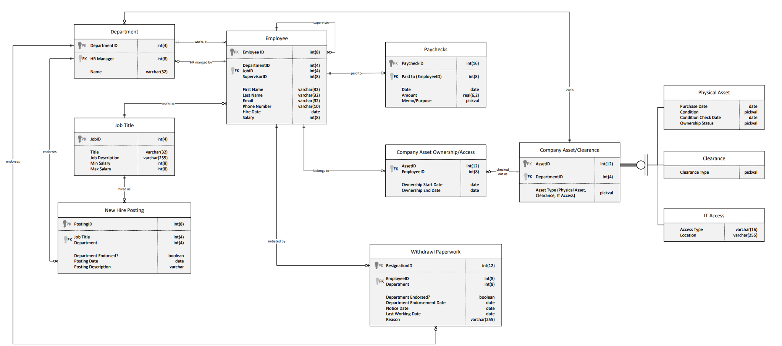

Slide 15
Data Dictionary

Slide 16
DATA DICTIONARY
Employee – Represents the employee at the company
PK Employee_ID (required) – sequentially assigned number to ensure employees have unique identifiers - int(8) – Ex. 01987451
FK DepartmentId (required) – Foreign Key to tie to the employee’s department. Compresses size of database so that repeating names (“Electrical Design”) do not take up more space. – int(4) – Ex. 0002
FK Supervisor_ID (required) - The Employee_ID of the individual supervising this employee. – int(8) – Ex. 01987452
FK JobId (required) – Ties to a separate entity describing the employee’s title. Compresses size of database so that repeating names (“Associate Director”) do not take up more space. – int(4) – Ex. 0001
First_Name (required) – Employee’s First name – varchar(32) – Ex. Alexander
Last_Name (required) – Employee’s last name – varchar(32) – Ex. Hamilton
Email (optional) - company assigned email address of the employee – varchar(32) – Ex. Alexander.Hamilton@pwc.com
Phone_Number (optional) – Employee’s 3-digit area code and 7-digit home phone number without dashes – varchar(10) – Ex. 2125552535
Hire_Date (required) – Date employee was hired – date – Ex. 2/23/2018
Salary (required) - Annual pay of the employee - int(8) - Ex. 100,000
Paychecks - Checks issued to employees including last paycheck and severance/benefits paychecks
Paycheck_Id (required) - sequentially assigned number to ensure each check is uniquely identifiable - int(16) - Ex. 0123456789012345
FK PaidTo (required) - EmployeeId of the recipient of the pay - int(8) - Ex. 01987451
Paycheck_Date - The day the check was cut/issued - date - Ex. 2/23/2023
Amount (required) - Dollars and cents given to the employee via the check - real(6,2) - Ex. $3255.84
Memo/Purpose (required) - A selectable field with limited options for categorizing/reporting checks - pickval - {salary, severance, final paycheck, benefit}
Department – Group of employees within the company that perform a similar function
PK Dept_Id (required) – sequentially assigned number to ensure departments have unique identifiers – int(4) – Ex. 0002
Name (required) – Common formal name given to the group of employees – varchar(32) – Ex. Electrical Design
FK HR_Manager (required) - The HR representative assigned to manage employment related to that department – int(8) – Ex. 01987459

Slide 17
DATA DICTIONARY
Job_Title – Represents different jobs around the company
PK Job_Id (required) – sequentially assigned number to ensure roles have unique identifiers – int(4) – Ex. 0001
Title (required) – What you call someone performing this role – varchar(32) – Ex. Associate director
JobDescription (required) - Basic description of job functions and responsibilities - varchar(255)
MinSalary (required) - Minimum annual salary for this role - int(8) - Ex. 60,000
MaxSalary (required) - Maximum annual salary for this role - int(8) - Ex. 150,000
New Hire Posting - Listing for a new employment opportunity to fill a gap in the organization
PK Posting_Id (required) - sequentially assigned number to ensure each posting record is retained and unique – int(8) – Ex. 01987452
FK JobTitleId (required) - JobId number associated with the posting. - int(4) - Ex. 0001
FK DeptId (required) - department for which the posting is devoted – int(4) – Ex. 0002
Department Endorsed? - whether the department functional manager and HR manager have endorsed the posting; the field is optional while the posting is being approved; endorsement is required prior to physical posting. - boolean - Ex. 0 or 1
PostingDate - filled when posted, the date that the opportunity is endorsed and posted; the field is optional while the posting is being approved; endorsement and date are required prior to physical posting. - date - Ex. 2/23/2023
PostingDescription (required) - Extra description for specific job responsibilities and requirements/recommendations to help applicants and HR - varchar(255)
Withdrawal_Paperwork -
PK ResignationId (required) – sequentially assigned number to ensure all resignations records are easily associated with clearances from each department – int(12) – ex. 012345678901
FK EmployeeId (required) – EmployeeId of the individual resigning to ensure (with resignation date) all resignations are unique – Int(8) – Ex. 01987451
FK DeptId (required) - department from which the employee is resigning from – int(4) – Ex. 0002
Department Endorsed? - whether the department functional manager and HR manage have endorsed the posting; the field is optional while the posting is being approved; endorsement is required prior to physical posting. - boolean - Ex. 0 or 1
Department Endorsement Date - the date that the withdrawal paperwork is endorsed by the department functional manager and HR manager; required prior to last working day. - date - Ex. 3/8/2023
NoticeDate (required) – This is the day the employee submitted their resignation to ensure (with employeeId) that all resignations are unique. – date – Ex. 2/23/2023
LastWorkingDay (required) - This is the day the employee intends to be the last working day - date - Ex. 3/10/2023
Reason (required) – more detailed description from employee why they are leaving the company – varchar (255) – Ex. “UPS made an offer with better pay and benefits.”, “More pay/Better benefits, Better location, Employee relocating, Less travel”, “Career change, Better company, Better working conditions”, etc.

Slide 18
DATA DICTIONARY
Company Asset Ownership/Access-
PK FK AssetId (required) – Identifier of a specific piece of equipment - int(12) - Ex. 223322334455
PK FK EmployeeId (required) – This is the employeeId of the person it was issued to – Int(8) – Ex. 01987451
OwnershipStartDate (required) – This is the date the equipment was issued to the employee – Date – Ex. 2/23/2018
OwnershipEndDate (optional) - This is the date the equipment was returned to the company – Date – Ex. 2/23/2023
Company Asset/Clearance
PK AssetId (required) - sequentially assigned number to ensure all assets and clearances are tagged/tracked - int(12) - Ex. 223322334455
FK DeptId (required) - This is the department responsible for granting/giving and revoking/reclaiming access/asset – int(4) – Ex. 0002
AssetType (required) - Type of equipment associated with this AssetId - pickval with options: {Physical Asset, Clearance, or IT Access}
Company Asset/Clearance Subtypes:
Physical Asset
PurchaseDate (required) - Useful for determining age/value of the asset, and/or need to replace - date - Ex. 2/23/2018
Asset_Condition (required) - What physical/functional condition is the asset in? Useful for determining the need to replace - pickval - Ex. unit pristine/new, standard wear/tear, degraded, or broken
ConditionCheckDate (required) - When was the condition last checked and updated - date - ex. 2/23/2018
OwnershipStatus (required) - Is the asset company owned or rented - pickval - Ex. owned, rented, or in stock.
Clearance
ClearanceType (required) - Some revoked clearances are simple manager notifications and sign-offs. Other revoked clearances may involve more handling than a simple turn in. If they involve some extra steps such as reprogramming locks, changing group passwords or placing an inspection stamp number on hold for 3 months, this field would be used for categorizing these- pickval - Ex. manager notice, Digital lock combination, group area password, inspection stamp, CUI database.
IT Access
AccessType (required) - 1-2 word name for the type of digital location – varchar(16) – Ex. Sharedrive, Software, Website, E-mail, or Database
Location (required) – if the location is a network location, this would be the //server/folder address. If the location is a database, this is the connection string. If the location is an intranet/internet website, this is the URL. – varchar(255) – Ex. //huskyGo/DataManagement/, https://autotime.company.com/, etc.

Slide 19
Table Creation SQL Code

Slide 20
SET FOREIGN_KEY_CHECKS = 0;
DROP TABLE IF EXISTS A_Department ;
DROP TABLE IF EXISTS A_Employee ;
DROP TABLE IF EXISTS A_Paycheck ;
DROP TABLE IF EXISTS A_Job_Title ;
DROP TABLE IF EXISTS A_New_Hire_Posting ;
DROP TABLE IF EXISTS A_Withdrawl_Paperwork ;
DROP TABLE IF EXISTS A_Company_Asset_Ownership ;
DROP TABLE IF EXISTS A_Company_Asset ;
DROP TABLE IF EXISTS A_Physical_Company_Asset ;
DROP TABLE IF EXISTS A_Clearance_Company_Asset ;
DROP TABLE IF EXISTS A_IT_Access_Company_Asset ;
-- ===========================================================================
-- Create employee table.
-- ===========================================================================
CREATE TABLE A_Employee
( Employee_ID INT(8) PRIMARY KEY
, Department_ID INT(4) NOT NULL
, Job_ID INT(4) NOT NULL
, Supervisor_ID INT(8) NOT NULL
, First_Name VARCHAR(32) NOT NULL
, Last_Name VARCHAR(32) NOT NULL
, Email VARCHAR(32)
, Phone_Number VARCHAR(10)
, Hire_Date DATE NOT NULL
, Salary INT(8) NOT NULL) ;
-- ===========================================================================
-- Create paycheck table.
-- ===========================================================================
CREATE TABLE A_Paycheck
( Paycheck_ID INT(16) PRIMARY KEY
, Paid_to_Employee_ID INT(8) NOT NULL
, Paycheck_Date DATE NOT NULL
, Amount REAL(6,2) NOT NULL
, Memo VARCHAR(20) NOT NULL
, CONSTRAINT Memo_pickval
CHECK (Memo in ('salary','severance','final paycheck','benefit'))) ;
-- ===========================================================================
-- Create department table.
-- ===========================================================================
CREATE TABLE A_Department
( Department_ID INT(4) PRIMARY KEY
, HR_Manager_Employee_ID INT(8) NOT NULL
, Name VARCHAR(32) NOT NULL) ;
-- ===========================================================================
-- Create job title table.
-- ===========================================================================
CREATE TABLE A_Job_Title
( Job_ID INT(4) PRIMARY KEY
, Title VARCHAR(32) NOT NULL
, Job_Description VARCHAR(255) NOT NULL
, MinSalary INT(8) NOT NULL
, MaxSalary INT(8) NOT NULL) ;
-- ===========================================================================
-- Create new hire posting table.
-- ===========================================================================
CREATE TABLE A_New_Hire_Posting
( Posting_ID INT(8) PRIMARY KEY
, Job_Title_ID INT(4) NOT NULL
, Department_ID INT(4) NOT NULL
, Department_Endorsed BOOL
, Posting_Date DATE
, Posting_Description VARCHAR(255) NOT NULL) ;
-- ===========================================================================
-- Create withdrawl paperwork table.
-- ===========================================================================
CREATE TABLE A_Withdrawl_Paperwork
( Resignation_ID INT(12) PRIMARY KEY
, Employee_ID INT(8) NOT NULL
, Department_ID INT(4) NOT NULL
, Department_Endorsed BOOL
, Notice_Date DATE
, Department_Endorsement_Date DATE NOT NULL
, Last_Working_Day DATE NOT NULL
, Reason VARCHAR(255) NOT NULL) ;
-- ===========================================================================
-- Create company asset ownership table.
-- ===========================================================================
CREATE TABLE A_Company_Asset_Ownership
( Asset_ID INT(12) NOT NULL
, Employee_ID INT(8) NOT NULL
, Ownership_Start_Date DATE NOT NULL
, Ownership_End_Date DATE) ;
-- ===========================================================================
-- Create company asset table.
-- ===========================================================================
CREATE TABLE A_Company_Asset
( Asset_ID INT(12) PRIMARY KEY
, Department_ID INT(4) NOT NULL
, Asset_Type VARCHAR(20) NOT NULL
, CONSTRAINT Asset_Type_pickval
CHECK (Asset_Type in ('Physical Asset','Clearance','IT Access'))) ;

Slide 21
-- ===========================================================================
-- Create physical asset subtype table.
-- ===========================================================================
CREATE TABLE A_Physical_Company_Asset
( Asset_ID INT(12) NOT NULL
, Purchase_Date DATE NOT NULL
, Asset_Condition VARCHAR(32) NOT NULL
, Condition_Check_Date DATE NOT NULL
, Ownership_Status VARCHAR(32) NOT NULL
, CONSTRAINT Condition_pickval
CHECK (Asset_Condition in ('unit pristine/new','standard wear/tear','degraded','broken'))
, CONSTRAINT Ownership_pickval
CHECK (Ownership_Status in ('owned','rented','in stock'))) ;
-- ===========================================================================
-- Create clearance subtype table.
-- ===========================================================================
CREATE TABLE A_Clearance_Company_Asset
( Asset_ID INT(12) NOT NULL
, Clearance_Type VARCHAR(64) NOT NULL
, CONSTRAINT Clearance_pickval
CHECK (Clearance_Type in ('Manager Notice', 'Digital Lock Combination','Group Area Password', 'Inspection Stamp', 'CUI Database'))) ;
-- ===========================================================================
-- Create IT access subtype table.
-- ===========================================================================
CREATE TABLE A_IT_Access_Company_Asset
( IT_Asset_ID INT(12) NOT NULL
, Access_Type VARCHAR(32) NOT NULL
, Location VARCHAR(255) NOT NULL) ;
-- ===========================================================================
-- Create foreign keys.
-- ===========================================================================
ALTER TABLE A_Department
ADD CONSTRAINT FOREIGN KEY (HR_Manager_Employee_ID)
REFERENCES A_Employee(Employee_ID);
ALTER TABLE A_Employee
ADD CONSTRAINT FOREIGN KEY (Department_ID)
REFERENCES A_Department(Department_ID);
ALTER TABLE A_Employee
ADD CONSTRAINT FOREIGN KEY (Job_ID)
REFERENCES A_Job_Title(Job_ID);
ALTER TABLE A_Employee
ADD CONSTRAINT FOREIGN KEY (Supervisor_ID)
REFERENCES A_Employee(Employee_ID);
ALTER TABLE A_New_Hire_Posting
ADD CONSTRAINT FOREIGN KEY (Job_Title_ID)
REFERENCES A_Job_Title(Job_ID);
ALTER TABLE A_New_Hire_Posting
ADD CONSTRAINT FOREIGN KEY (Department_ID)
REFERENCES A_Department(Department_ID);
ALTER TABLE A_Paycheck
ADD CONSTRAINT FOREIGN KEY (Paid_to_Employee_ID)
REFERENCES A_Employee(Employee_ID);
ALTER TABLE A_Withdrawl_Paperwork
ADD CONSTRAINT FOREIGN KEY (Employee_ID)
REFERENCES A_Employee(Employee_ID);
ALTER TABLE A_Withdrawl_Paperwork
ADD CONSTRAINT FOREIGN KEY (Department_ID)
REFERENCES A_Department(Department_ID);
ALTER TABLE A_Company_Asset_Ownership
ADD CONSTRAINT FOREIGN KEY (Asset_ID)
REFERENCES A_Company_Asset(Asset_ID);
ALTER TABLE A_Company_Asset_Ownership
ADD CONSTRAINT FOREIGN KEY (Employee_ID)
REFERENCES A_Employee(Employee_ID);
ALTER TABLE A_Company_Asset
ADD CONSTRAINT FOREIGN KEY (Department_ID)
REFERENCES A_Department(Department_ID);
ALTER TABLE A_Physical_Company_Asset
ADD CONSTRAINT FOREIGN KEY (P_Asset_ID)
REFERENCES A_Company_Asset(Asset_ID);
ALTER TABLE A_Clearance_Company_Asset
ADD CONSTRAINT FOREIGN KEY (C_Asset_ID)
REFERENCES A_Company_Asset(Asset_ID);
ALTER TABLE A_IT_Access_Company_Asset
ADD CONSTRAINT FOREIGN KEY (IT_Asset_ID)
REFERENCES A_Company_Asset(Asset_ID);

Slide 22
Record Creation SQL Code

Slide 23
-- SELECT * FROM A_Department;
-- SET define OFF
SET FOREIGN_KEY_CHECKS = 0;
-- insert values into A_Department
INSERT INTO A_Department VALUES (0001,00000013,'Sales');
INSERT INTO A_Department VALUES (0002,00000013,'Purchasing');
INSERT INTO A_Department VALUES (0003,00000016,'Receiving');
INSERT INTO A_Department VALUES (0004,00000016,'Kitting');
INSERT INTO A_Department VALUES (0005,00000016,'Manufacturing');
INSERT INTO A_Department VALUES (0006,00000016,'Inspection');
INSERT INTO A_Department VALUES (0007,00000016,'Shipping');
INSERT INTO A_Department VALUES (0008,00000013,'IT');
INSERT INTO A_Department VALUES (0009,00000013,'Operations');
INSERT INTO A_Department VALUES (0010,00000016,'Human Resources');
-- insert values into A_Employee
INSERT INTO A_Employee VALUES (00000001,0001,0001,00000012,'Stanley','Mayer','Stanley.Mayer@company.com',8605077700,'2003-03-31',00080800);
INSERT INTO A_Employee VALUES (00000002,0001,0002,00000012,'Ryland','Everett','Ryland.Everett@company.com',8605189154,'2003-12-31',00149100);
INSERT INTO A_Employee VALUES (00000003,0003,0003,00000018,'Jaylin','Cline','Jaylin.Cline@company.com',8605207563,'2004-10-23',00106900);
INSERT INTO A_Employee VALUES (00000004,0007,0004,00000024,'Ashtyn','Chapman','Ashtyn.Chapman@company.com',8605182445,'2005-03-11',00159500);
INSERT INTO A_Employee VALUES (00000005,0001,0005,00000012,'Dominique','Barton','Dominique.Barton@company.com',8605002216,'2005-03-23',00046200);
INSERT INTO A_Employee VALUES (00000006,0008,0006,00000017,'Amirah','Pugh','Amirah.Pugh@company.com',8605253880,'2007-02-26',00080800);
INSERT INTO A_Employee VALUES (00000007,0002,0007,00000021,'Austin','Jarvis','Austin.Jarvis@company.com',8605122833,'2008-03-18',00131900);
INSERT INTO A_Employee VALUES (00000008,0009,0008,00000020,'Gunner','Schmidt','Gunner.Schmidt@company.com',8605131574,'2009-06-14',00087600);
INSERT INTO A_Employee VALUES (00000009,0006,0009,00000023,'Kaila','Harmon','Kaila.Harmon@company.com',8605229749,'2009-07-30',00062900);
INSERT INTO A_Employee VALUES (00000010,0008,0010,00000017,'Jabari','Robertson','Jabari.Robertson@company.com',8605091946,'2010-09-04',00050000);
INSERT INTO A_Employee VALUES (00000011,0004,0011,00000011,'Jewel','Diaz','Jewel.Diaz@company.com',8605168539,'2010-09-13',00141500);
INSERT INTO A_Employee VALUES (00000012,0001,0012,00000012,'Jose','Torres','Jose.Torres@company.com',8605168895,'2011-09-20',00178100);
INSERT INTO A_Employee VALUES (00000013,0010,0013,00000013,'Zayden','Norman','Zayden.Norman@company.com',8605202063,'2012-02-23',00059900);
INSERT INTO A_Employee VALUES (00000014,0007,0014,00000024,'Russell','Nash','Russell.Nash@company.com',8605255532,'2013-07-16',00057000);
INSERT INTO A_Employee VALUES (00000015,0009,0015,00000020,'Brodie','Page','Brodie.Page@company.com',8605153058,'2013-10-09',00144400);
INSERT INTO A_Employee VALUES (00000016,0010,0016,00000013,'Aubree','Morgan','Aubree.Morgan@company.com',8605203918,'2014-04-23',00123000);
INSERT INTO A_Employee VALUES (00000017,0008,0017,00000017,'Ayana','Reynolds','Ayana.Reynolds@company.com',8605077291,'2015-08-17',00150200);
INSERT INTO A_Employee VALUES (00000018,0003,0018,00000018,'Rachel','Pratt','Rachel.Pratt@company.com',8605019217,'2016-07-20',00045700);
INSERT INTO A_Employee VALUES (00000019,0005,0019,00000019,'Finley','Wagner','Finley.Wagner@company.com',8605083405,'2017-07-30',00167700);
INSERT INTO A_Employee VALUES (00000020,0009,0020,00000020,'Regina','Elliott','Regina.Elliott@company.com',8605053733,'2017-08-10',00084100);
INSERT INTO A_Employee VALUES (00000021,0002,0021,00000021,'Meadow','Rubio','Meadow.Rubio@company.com',8605194781,'2019-04-30',00148700);
INSERT INTO A_Employee VALUES (00000022,0008,0022,00000017,'Tiana','Hubbard','Tiana.Hubbard@company.com',8605121838,'2020-10-24',00071000);
INSERT INTO A_Employee VALUES (00000023,0006,0023,00000023,'Madden','Kaiser','Madden.Kaiser@company.com',8605083537,'2021-04-19',00074600);
INSERT INTO A_Employee VALUES (00000024,0007,0024,00000024,'Madilynn','Fernandez','Madilynn.Fernandez@company.com',8605133464,'2022-03-13',00068900);
INSERT INTO A_Employee VALUES (00000025,0005,0025,00000019,'Maximus','Buckley','Maximus.Buckley@company.com',8605206896,'2022-03-25',00117000);
-- insert values into A_Paycheck
INSERT INTO A_Paycheck VALUES (0000000000001001,00000011,'2023-03-15',04716.67,'salary');
INSERT INTO A_Paycheck VALUES (0000000000001002,00000012,'2023-03-15',05936.67,'salary');
INSERT INTO A_Paycheck VALUES (0000000000001003,00000013,'2023-03-15',01996.67,'salary');
INSERT INTO A_Paycheck VALUES (0000000000001004,00000014,'2023-03-15',01900.00,'salary');
INSERT INTO A_Paycheck VALUES (0000000000001005,00000015,'2023-03-15',04813.33,'salary');
INSERT INTO A_Paycheck VALUES (0000000000001006,00000016,'2023-03-15',04100.00,'salary');

Slide 24
INSERT INTO A_Paycheck VALUES (0000000000001007,00000017,'2023-03-15',05006.67,'salary');
INSERT INTO A_Paycheck VALUES (0000000000001008,00000018,'2023-03-15',01523.33,'salary');
INSERT INTO A_Paycheck VALUES (0000000000001009,00000019,'2023-03-15',05590.00,'salary');
INSERT INTO A_Paycheck VALUES (0000000000001010,00000020,'2023-03-15',02803.33,'salary');
INSERT INTO A_Paycheck VALUES (0000000000001011,00000014,'2023-03-23',01900.00,'final paycheck');
-- insert values into A_Job_Title
INSERT INTO A_Job_Title VALUES (0001,'Sales Account Manager','Navigates Customer negotiations. Reviews and processes purchase orders.',00061000,00113000);
INSERT INTO A_Job_Title VALUES (0002,'Sales Senior Account Manager','Navigates Customer negotiations. Reviews and processes purchase orders.',00142000,00265000);
INSERT INTO A_Job_Title VALUES (0003,'Receiving Manager','Receives in materials from vendors, inspects for quality, maintains an orderly stock room.',00080000,00150000);
INSERT INTO A_Job_Title VALUES (0004,'Shipping Senior Manager','Packages product in protective wrapping based on customer requirements.',00120000,00223000);
INSERT INTO A_Job_Title VALUES (0005,'Sales Account Manager','Navigates Customer negotiations. Reviews and processes purchase orders.',00035000,00065000);
INSERT INTO A_Job_Title VALUES (0006,'IT Associate','Maintain''s company''s digital infrastructure',00061000,00113000);
INSERT INTO A_Job_Title VALUES (0007,'Purchasing Engineer','Reviews SAP for MRP scheduling and places Purchase Orders with suppliers.',00099000,00185000);
INSERT INTO A_Job_Title VALUES (0008,'Operations Manager','Manages workflow to maximize efficiency, productivity and profitability. Manages expedite orders.',00066000,00123000);
INSERT INTO A_Job_Title VALUES (0009,'Inspection Manager','Inspects finished product for quality. Performs minor rework to ensure product meets customer requirements. Recommends process changes to improve quality out of manufacturing.',00047000,00088000);
INSERT INTO A_Job_Title VALUES (0010,'IT Associate','Maintain''s company''s digital infrastructure',00038000,00070000);
INSERT INTO A_Job_Title VALUES (0011,'Kitting Senior Director','Obtains materials from stock room based on pick list for the job, delivers to manufacturing room.',00106000,00198000);
INSERT INTO A_Job_Title VALUES (0012,'Sales Senior Account Manager','Navigates Customer negotiations. Reviews and processes purchase orders.',00134000,00249000);
INSERT INTO A_Job_Title VALUES (0013,'Human Resources Senior Associate','Manages personnel conflicts, hirings and separations.',00045000,00084000);
INSERT INTO A_Job_Title VALUES (0014,'Shipping Technician','Packages product in protective wrapping based on customer requirements.',00043000,00080000);
INSERT INTO A_Job_Title VALUES (0015,'Operations Senior Manager','Manages workflow to maximize efficiency, productivity and profitability. Manages expedite orders.',00108000,00202000);
INSERT INTO A_Job_Title VALUES (0016,'Human Resources Senior Associate','Manages personnel conflicts, hirings and separations.',00092000,00172000);
INSERT INTO A_Job_Title VALUES (0017,'IT Associate','Maintain''s company''s digital infrastructure',00113000,00210000);
INSERT INTO A_Job_Title VALUES (0018,'Receiving Clerk','Receives in materials from vendors, inspects for quality, maintains an orderly stock room.',00034000,00064000);
INSERT INTO A_Job_Title VALUES (0019,'Manufacturing Engineer','Assembles materials into finished product. Follows work instruction. Assembly skill required.',00126000,00235000);
INSERT INTO A_Job_Title VALUES (0020,'Operations Manager','Manages workflow to maximize efficiency, productivity and profitability. Manages expedite orders.',00063000,00118000);
INSERT INTO A_Job_Title VALUES (0021,'Purchasing Senior Manager','Reviews SAP for MRP scheduling and places Purchase Orders with suppliers.',00112000,00208000);
INSERT INTO A_Job_Title VALUES (0022,'IT Clerk','Maintain''s company''s digital infrastructure',00053000,00099000);
INSERT INTO A_Job_Title VALUES (0023,'Inspection Associate','Inspects finished product for quality. Performs minor rework to ensure product meets customer requirements. Recommends process changes to improve quality out of manufacturing.',00056000,00104000);
INSERT INTO A_Job_Title VALUES (0024,'Shipping Senior Manager','Packages product in protective wrapping based on customer requirements.',00052000,00096000);
INSERT INTO A_Job_Title VALUES (0025,'Manufacturing Manager','Assembles materials into finished product. Follows work instruction. Assembly skill required.',00088000,00164000);
-- insert values into A_New_Hire_Posting
INSERT INTO A_New_Hire_Posting VALUES (00000001,0012,0001,1,'2023-03-23','Navigates Customer negotiations. Reviews and processes purchase orders.');
INSERT INTO A_New_Hire_Posting VALUES (00000002,0021,0002,1,'2023-03-23','Reviews SAP for MRP scheduling and places Purchase Orders with suppliers.');
INSERT INTO A_New_Hire_Posting VALUES (00000003,0018,0003,1,'2023-03-23','Receives in materials from vendors, inspects for quality, maintains an orderly stock room.');
INSERT INTO A_New_Hire_Posting VALUES (00000004,0011,0004,1,'2023-03-23','Obtains materials from stock room based on pick list for the job, delivers to manufacturing room.');

Slide 25
INSERT INTO A_New_Hire_Posting VALUES (00000005,0019,0005,1,'2023-03-23','Assembles materials into finished product. Follows work instruction. Assembly skill required.');
INSERT INTO A_New_Hire_Posting VALUES (00000006,0023,0006,1,'2023-03-23','Inspects finished product for quality. Performs minor rework to ensure product meets customer requirements. Recommends process changes to improve quality out of manufacturing.');
INSERT INTO A_New_Hire_Posting VALUES (00000007,0024,0007,1,'2023-03-23','Packages product in protective wrapping based on customer requirements.');
INSERT INTO A_New_Hire_Posting VALUES (00000008,0017,0008,1,'2023-03-23','Maintain''s company''s digital infrastructure');
INSERT INTO A_New_Hire_Posting VALUES (00000009,0020,0009,0,'2023-03-23','Manages workflow to maximize efficiency, productivity and profitability. Manages expedite orders.');
INSERT INTO A_New_Hire_Posting VALUES (00000010,0013,0010,0,'2023-03-23','Manages personnel conflicts, hirings and separations.');
-- insert values into A_Withdrawl_Paperwork
INSERT INTO A_Withdrawl_Paperwork VALUES (000000000001,00000001,0001,1,'2022-09-13','2022-09-20','2022-10-04','Better Pay');
INSERT INTO A_Withdrawl_Paperwork VALUES (000000000002,00000002,0001,0,'2023-01-07','2023-01-14','2023-01-23','Better Pay');
INSERT INTO A_Withdrawl_Paperwork VALUES (000000000003,00000003,0003,1,'2022-05-24','2022-05-31','2022-06-26','Better Pay');
INSERT INTO A_Withdrawl_Paperwork VALUES (000000000004,00000004,0007,1,'2022-09-20','2022-09-27','2022-10-18','Spouse Relocating');
INSERT INTO A_Withdrawl_Paperwork VALUES (000000000005,00000005,0001,1,'2022-11-05','2022-11-12','2022-11-23','Better Pay');
INSERT INTO A_Withdrawl_Paperwork VALUES (000000000006,00000006,0008,1,'2022-07-02','2022-07-09','2022-08-02','Better Location');
INSERT INTO A_Withdrawl_Paperwork VALUES (000000000007,00000007,0002,1,'2022-07-29','2022-08-05','2022-08-16','Better Location');
INSERT INTO A_Withdrawl_Paperwork VALUES (000000000008,00000008,0009,1,'2022-04-15','2022-04-22','2022-04-29','Spouse Relocating');
INSERT INTO A_Withdrawl_Paperwork VALUES (000000000009,00000009,0006,1,'2022-09-30','2022-10-07','2022-10-25','Better Location');
INSERT INTO A_Withdrawl_Paperwork VALUES (000000000010,00000014,0007,1,'2022-11-24','2022-12-01','2022-12-23','Better Pay');
-- insert values into A_Company_Asset_Ownership
INSERT INTO A_Company_Asset_Ownership VALUES (000000000001,00000001,'2003-04-01','2022-10-03');
INSERT INTO A_Company_Asset_Ownership VALUES (000000000002,00000002,'2004-01-01','2023-01-22');
INSERT INTO A_Company_Asset_Ownership VALUES (000000000003,00000003,'2004-10-24','2022-06-25');
INSERT INTO A_Company_Asset_Ownership VALUES (000000000004,00000004,'2005-03-12','2022-10-17');
INSERT INTO A_Company_Asset_Ownership VALUES (000000000005,00000005,'2005-03-24','2022-11-22');
INSERT INTO A_Company_Asset_Ownership VALUES (000000000006,00000006,'2007-02-27','2022-08-01');
INSERT INTO A_Company_Asset_Ownership VALUES (000000000007,00000007,'2008-03-19','2022-08-15');
INSERT INTO A_Company_Asset_Ownership VALUES (000000000008,00000014,'2013-07-17',NULL);
INSERT INTO A_Company_Asset_Ownership VALUES (000000000009,00000014,'2013-07-17',NULL);
INSERT INTO A_Company_Asset_Ownership VALUES (000000000010,00000014,'2013-07-17',NULL);
-- insert values into A_Company_Asset
INSERT INTO A_Company_Asset VALUES (000000000001,0008,'IT Access');
INSERT INTO A_Company_Asset VALUES (000000000002,0008,'IT Access');
INSERT INTO A_Company_Asset VALUES (000000000003,0008,'IT Access');
INSERT INTO A_Company_Asset VALUES (000000000004,0008,'IT Access');
INSERT INTO A_Company_Asset VALUES (000000000005,0008,'IT Access');
INSERT INTO A_Company_Asset VALUES (000000000006,0008,'IT Access');
INSERT INTO A_Company_Asset VALUES (000000000007,0008,'IT Access');
INSERT INTO A_Company_Asset VALUES (000000000008,0009,'Clearance');
INSERT INTO A_Company_Asset VALUES (000000000009,0010,'Physical Asset');
INSERT INTO A_Company_Asset VALUES (000000000010,0008,'IT Access');
INSERT INTO A_Company_Asset VALUES (000000000011,0009,'Clearance');
INSERT INTO A_Company_Asset VALUES (000000000012,0009,'Clearance');
INSERT INTO A_Company_Asset VALUES (000000000013,0009,'Clearance');
INSERT INTO A_Company_Asset VALUES (000000000014,0009,'Clearance');
INSERT INTO A_Company_Asset VALUES (000000000015,0009,'Clearance');

Slide 26
INSERT INTO A_Company_Asset VALUES (000000000016,0009,'Clearance');
INSERT INTO A_Company_Asset VALUES (000000000017,0009,'Clearance');
INSERT INTO A_Company_Asset VALUES (000000000018,0009,'Clearance');
INSERT INTO A_Company_Asset VALUES (000000000019,0009,'Clearance');
INSERT INTO A_Company_Asset VALUES (000000000020,0008,'IT Access');
INSERT INTO A_Company_Asset VALUES (000000000021,0008,'IT Access');
INSERT INTO A_Company_Asset VALUES (000000000022,0010,'Physical Asset');
INSERT INTO A_Company_Asset VALUES (000000000023,0010,'Physical Asset');
INSERT INTO A_Company_Asset VALUES (000000000024,0010,'Physical Asset');
INSERT INTO A_Company_Asset VALUES (000000000025,0010,'Physical Asset');
INSERT INTO A_Company_Asset VALUES (000000000026,0010,'Physical Asset');
INSERT INTO A_Company_Asset VALUES (000000000027,0010,'Physical Asset');
INSERT INTO A_Company_Asset VALUES (000000000028,0010,'Physical Asset');
INSERT INTO A_Company_Asset VALUES (000000000029,0010,'Physical Asset');
INSERT INTO A_Company_Asset VALUES (000000000030,0010,'Physical Asset');
-- insert values into A_Clearance_Company_Asset
INSERT INTO A_Clearance_Company_Asset VALUES (000000000008,'Group Area Password');
INSERT INTO A_Clearance_Company_Asset VALUES (000000000011,'Group Area Password');
INSERT INTO A_Clearance_Company_Asset VALUES (000000000012,'Group Area Password');
INSERT INTO A_Clearance_Company_Asset VALUES (000000000013,'Group Area Password');
INSERT INTO A_Clearance_Company_Asset VALUES (000000000014,'Group Area Password');
INSERT INTO A_Clearance_Company_Asset VALUES (000000000015,'Group Area Password');
INSERT INTO A_Clearance_Company_Asset VALUES (000000000016,'Digital Lock Combination');
INSERT INTO A_Clearance_Company_Asset VALUES (000000000017,'Inspection Stamp');
INSERT INTO A_Clearance_Company_Asset VALUES (000000000018,'Manager Notice');
INSERT INTO A_Clearance_Company_Asset VALUES (000000000019,'Manager Notice');
-- insert values into A_Physical_Company_Asset
INSERT INTO A_Physical_Company_Asset VALUES (000000000009,'2017-07-17','unit pristine/new','2017-07-17','owned');
INSERT INTO A_Physical_Company_Asset VALUES (000000000022,'2017-07-17','unit pristine/new','2017-07-17','owned');
INSERT INTO A_Physical_Company_Asset VALUES (000000000023,'2017-07-17','unit pristine/new','2017-07-17','owned');
INSERT INTO A_Physical_Company_Asset VALUES (000000000024,'2017-07-17','unit pristine/new','2017-07-17','owned');
INSERT INTO A_Physical_Company_Asset VALUES (000000000025,'2017-07-17','unit pristine/new','2017-07-17','owned');
INSERT INTO A_Physical_Company_Asset VALUES (000000000026,'2021-02-12','unit pristine/new','2021-02-12','owned');
INSERT INTO A_Physical_Company_Asset VALUES (000000000027,'2021-02-12','unit pristine/new','2021-02-12','owned');
INSERT INTO A_Physical_Company_Asset VALUES (000000000028,'2021-02-12','unit pristine/new','2021-02-12','owned');
INSERT INTO A_Physical_Company_Asset VALUES (000000000029,'2021-02-12','unit pristine/new','2021-02-12','owned');
INSERT INTO A_Physical_Company_Asset VALUES (000000000030,'2021-02-12','unit pristine/new','2021-02-12','owned');
-- insert values into A_IT_Access_Company_Asset
INSERT INTO A_IT_Access_Company_Asset VALUES (000000000001,'Sharedrive','//PWC.com/Groups');
INSERT INTO A_IT_Access_Company_Asset VALUES (000000000002,'Sharedrive','//PWC.com/Groups');
INSERT INTO A_IT_Access_Company_Asset VALUES (000000000003,'Sharedrive','//PWC.com/Groups');
INSERT INTO A_IT_Access_Company_Asset VALUES (000000000004,'Sharedrive','//PWC.com/Groups');
INSERT INTO A_IT_Access_Company_Asset VALUES (000000000005,'Sharedrive','//PWC.com/Groups');
INSERT INTO A_IT_Access_Company_Asset VALUES (000000000006,'Sharedrive','//PWC.com/Groups');
INSERT INTO A_IT_Access_Company_Asset VALUES (000000000007,'Sharedrive','//PWC.com/Groups');
INSERT INTO A_IT_Access_Company_Asset VALUES (000000000010,'Sharedrive','//PWC.com/Groups');
INSERT INTO A_IT_Access_Company_Asset VALUES (000000000020,'Sharedrive','//PWC.com/Groups');
INSERT INTO A_IT_Access_Company_Asset VALUES (000000000021,'Sharedrive','//PWC.com/Groups');

Slide 27
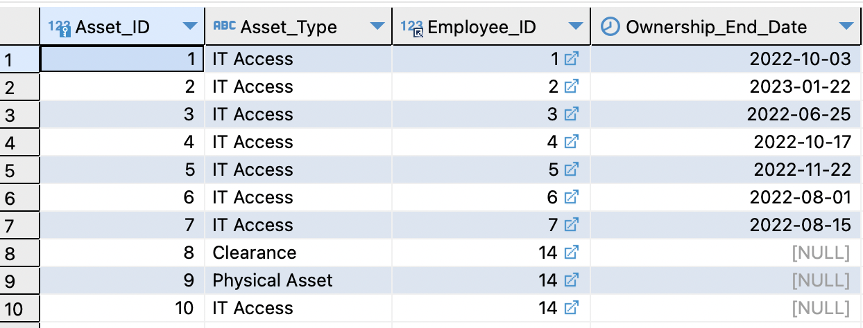
SQL Queries
Query #1:
SELECT Department_ID , DATEDIFF(Department_Endorsement_Date,Notice_Date) AS "Endorsement Duration in Days"
FROM A_Withdrawl_Paperwork
GROUP BY Department_ID
Query #2:
SELECT e.First_Name, e.Last_Name , e.Salary ,j.Title , j.MinSalary , j.MaxSalary , if(e.Salary BETWEEN j.MinSalary AND j.MaxSalary, 'Salary Within Normal Range', 'Salary Not Within Normal Range')
FROM A_Employee e
JOIN A_Withdrawl_Paperwork w
ON (e.Employee_ID = w.Employee_ID)
JOIN A_Job_Title j
ON (e.Job_ID = j.Job_ID)
Query #3:
SELECT ca.Asset_ID , ca.Asset_Type , co.Employee_ID, co.Ownership_End_Date
FROM A_Company_Asset ca
JOIN A_Company_Asset_Ownership co
ON(ca.Asset_ID=co.Asset_ID)
JOIN A_Withdrawl_Paperwork awp
ON(awp.Employee_ID = co.employee_id)

Slide 28
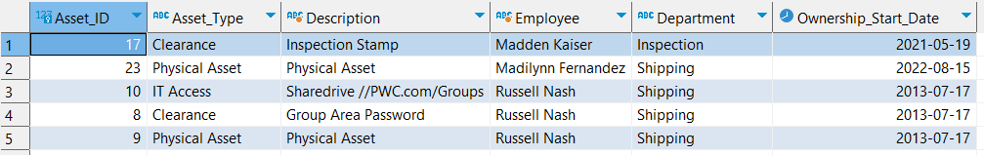
SQL Query #4:
SELECT P_Asset_ID,
Asset_Type,
SUM(DATEDIFF(IF(Ownership_End_Date IS NULL, '2023-04-07',Ownership_End_Date),Ownership_Start_Date)) as 'Days Issued',
MIN(Ownership_Start_Date) as 'First issue date',
MAX(Ownership_End_Date) as 'Last turn-in date',
COUNT(ALL Ownership_Start_Date) as 'Times issued',
IF(Ownership_Start_Date is NULL, 'Never Issued', CONCAT(
ROUND(100*SUM(DATEDIFF(IF(Ownership_End_Date IS NULL, '2023-04-07',
Ownership_End_Date), Ownership_Start_Date)) /
DATEDIFF('2023-04-07',Purchase_Date)
),'%')
) as 'Utilization',
Purchase_Date,
FLOOR(DATEDIFF('2023-04-07',Purchase_Date)/365) as 'Years Owned',
MOD(DATEDIFF('2023-04-07',Purchase_Date),365) as 'Days Owned'
FROM A_Company_Asset a RIGHT JOIN A_Physical_Company_Asset p on a.Asset_ID = p.P_Asset_ID
LEFT JOIN A_Company_Asset_Ownership o on o.Asset_ID = a.Asset_ID
GROUP BY P_Asset_ID
SQL Query #5:
SELECT aca.Asset_ID,
aca.Asset_Type,
(CASE WHEN aca.Asset_Type = 'IT Asset' THEN CONCAT(aiaca.Access_Type,' ', aiaca.Location)
WHEN aca.Asset_Type = 'Clearance' THEN Clearance_Type
ELSE Asset_Type END) as 'Description',
CONCAT(ae.First_Name, ' ', ae.Last_Name) as 'Employee',
ad.Name as 'Department',
Ownership_Start_Date
FROM A_Company_Asset_Ownership acao LEFT JOIN A_Company_Asset aca on acao.Asset_ID = aca.Asset_ID
LEFT JOIN A_Clearance_Company_Asset acca on acca.C_Asset_ID = aca.Asset_ID
LEFT JOIN A_IT_Access_Company_Asset aiaca on aiaca.IT_Asset_ID = aca.Asset_ID
LEFT JOIN A_Employee ae on acao.Employee_ID = ae.Employee_ID
LEFT JOIN A_Department ad on ae.Department_ID = ad.Department_ID
WHERE Ownership_End_Date IS NULL
ORDER BY ad.Name, ae.First_Name, ae.Last_Name

